Slide 1

Data Communication CSE 315
Dr. A.K.M. Muzahidul Islam
Professor
Computer Science & Engineering (CSE)
United International University (UIU)
Fall 2018

Slide 2
Resources
B. A. Forouzen Chapter 4

Slide 3
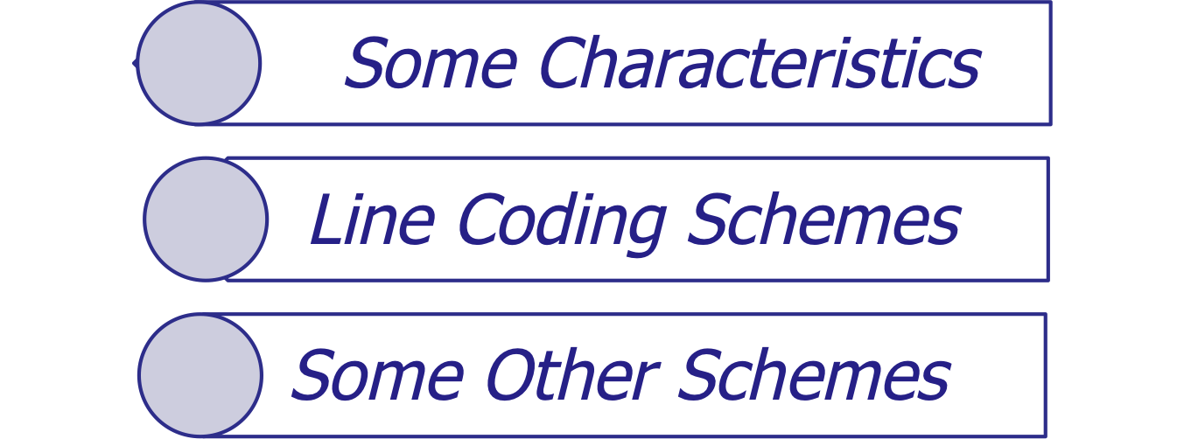
Outline

Slide 4
Line Coding
Converting a string of 1’s and 0’s (digital data) into a sequence of signals that denote the 1’s and 0’s.
For example a high voltage level (+V) could represent a “1” and a low voltage level (0 or -V) could represent a “0”.
4.<number>

Slide 5
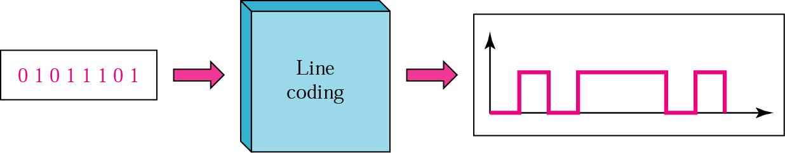
Digital Transmission
(Line Coding)
Converting sequence of bits into digital signal.
Example: 01011101 -> Line Coding ->
0- Low Signal
1 – High Signal
Figure 4.1 Line coding

Slide 6

Figure 4.2 Line coding and decoding
4.<number>

Slide 7
Properties of Line Coding
Bandwidth use is reduced
The power is efficiently used
Probability of error is reduced
Error detection and correction capabilities
Cross talk between channels is minimized
Notes:
Error detection - errors occur during transmission due to line impairments.
Some codes are constructed such that when an error occurs it can be detected.

Slide 8
Line encoding
To correctly interpret the signals received from the sender, the receiver’s bit intervals must correspond exactly to the sender’s bit intervals.
Self synchronization - the clocks at the sender and the receiver must have the same bit interval.
If the receiver clock is faster or slower it will misinterpret the incoming bit stream.
4.<number>

Slide 9

Figure 4.3 Effect of lack of synchronization
The receiver has a shorter bit duration.
The sender sends 10110001
The receiver receives 110111000011.
4.<number>

Slide 10
Example
In a digital transmission, the receiver clock is 0.1 percent faster than the sender clock. How many extra bits per second does the receiver receives if the data rate is 1 kbps? How many if the data rate is 1 Mbps?
Solutions:
At 1 kbps, the receiver receives 1001 bps instead of 1000 bps.
1000 bits sent 1001 bit received 1 extra bps
At 1 Mbps, the receiver receives 1,001,000 bps instead of 1,000,000 bps.
1,000,000 bits sent 1,001,000 bits received
1000 extra bps
4.<number>

Slide 11
Given, receiver clock is 0.1% faster than sender clock.
At 1 Mbps bits send by sender = 1000000 receiver clock is 0.1% faster than sender clock
So Extra bits received by receiver =
1000000 * (0.1/100) =1000 bits
Total bits received by received = 1001000 bits Extra bit per second received by receiver = 1000 bps.
4.<number>

Slide 12

Figure 4.4 Line coding schemes
4.<number>

Slide 13
Classification of Line Coding
Unipolar
  Uses only one voltage level other than 0
  e.g. RZ and NRZ
Polar
  Uses two voltage level other than 0
  RZ, NRZ, Manchester
Bipolar
  Uses three voltage levels positive, negative, and zero
  E.g., AMI

Slide 14
Unipolar
All signal levels are on one side of the time axis - either above or below
It has no synchronization
No error detection
costly in power consumption.
Advantage:
Simple
4.<number>

Slide 15
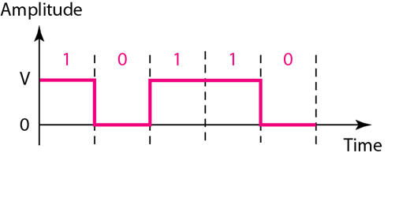
Figure 4.5.1 Unipolar NRZ scheme
Exercise : 10011100
00101110
NRZ (Non-Return-to-Zero) – Signal does not return to zero at the middle of the bit.
Positive Voltage defines bit 1
Zero voltage defines bit 0.
4.<number>
Notes:
Power needed to send 1 bit per unit line resistance.

Slide 16
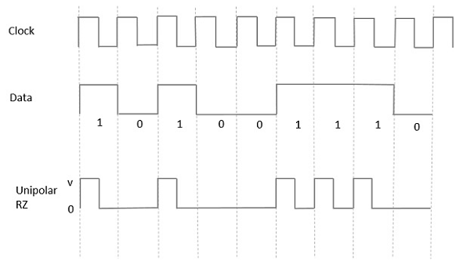
Figure 4.5.2 Unipolar RZ scheme
In this type of unipolar signaling,
Half of the bit duration remains high but it immediately returns to zero and shows the absence of pulse during the remaining half of the bit duration.
Exercise : 10011100
00101110
Advantages
It is simple.
The spectral line present at the symbol rate can be used as a clock.
Disadvantages
No error correction.
Occupies twice the bandwidth as unipolar NRZ.
Notes:
Power needed to send 1 bit per unit line resistance.

Slide 17
Polar - NRZ
The voltages are on both sides of the time axis. (+V and -V)
Polar NRZ scheme can be implemented with two voltages. e.g. +V for 1 and -V for 0.
There are two versions:
  NRZ - Level (NRZ-L) - positive voltage for one symbol and negative for the other
  NRZ - Inversion (NRZ-I) - the change or lack of change in polarity determines the value of a symbol. E.g. a “1” symbol inverts the polarity a “0” does not.
4.<number>

Slide 18
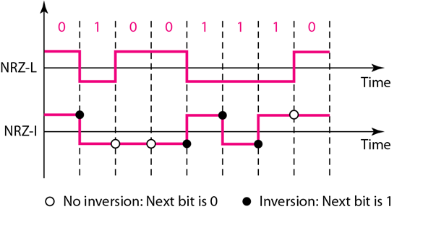
Figure 4.6 Polar NRZ-L and NRZ-I schemes
0-Hero
1-Zeo
Exercise: (i) 100110101
(ii) 110101011
0-No Transition
1-Transition
Exercise: (i) 100111100
(ii) 001011100
4.<number>

Slide 19

Note
In NRZ-L the level of the voltage determines the value of the bit.
In NRZ-I the inversion
or the lack of inversion
determines the value of the bit.
4.<number>

Slide 20
Note
NRZ-L and NRZ-I both have no self synchronization &no error detection. Both are relatively simple to implement.
4.<number>

Slide 21
Polar - RZ
The Return to Zero (RZ) scheme uses three voltage values. +V, 0V, -V.
Each symbol has a transition in the middle. Either from high to zero or from low to zero.
This scheme has more signal transitions (two per bit) and therefore requires a wider bandwidth.
Self synchronization - transition indicates symbol value.(Advantage)
More complex as it uses three voltage level. It has no error detection capability.(Disadvantage.)
4.<number>

Slide 22
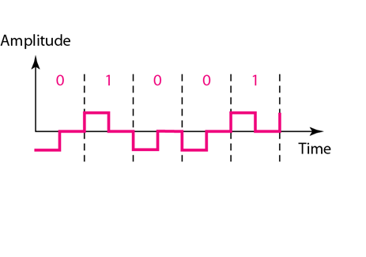
Figure 4.7 Polar RZ scheme
1- “z” shape in the above
0- reverse “z” shape below
Exercise: 110011000
110001011
4.<number>

Slide 23
Polar - Biphase: Manchester and Differential Manchester
Manchester coding consists of combining the NRZ-L and RZ schemes.
  Every symbol has a level transition in the middle: from high to low or low to high.
  Uses only two voltage levels.
Differential Manchester coding consists of combining the NRZ-I and RZ schemes.
  Every symbol has a level transition in the middle. But the level at the beginning of the symbol is determined by the symbol value. One symbol causes a level change the other does not.
4.<number>

Slide 24
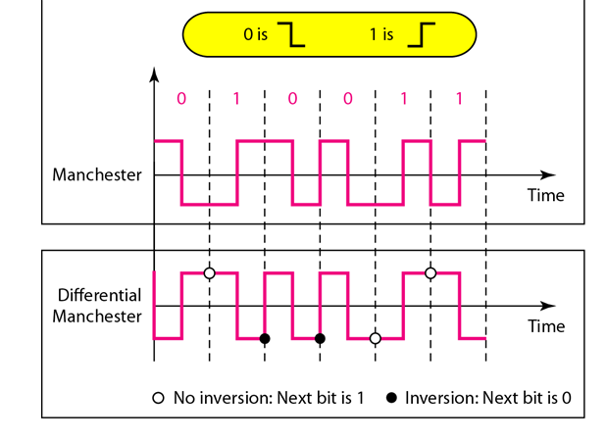
Figure 4.8 Polar biphase: Manchester and differential Manchester schemes
Exercise: (i) 10011010
(ii) 10011100
0- Transition
1-No Transition
Exercise: (i) 11010101
(ii) 01101101
First time always negative to
positive transition.
4.<number>

Slide 25
Note
In Manchester and differential Manchester encoding, the transition
at the middle of the bit is used for synchronization.
4.<number>

Slide 26
Bipolar - AMI and Pseudoternary
Code uses 3 voltage levels: - +V, 0, -V, to represent the symbols (note not transitions to zero as in RZ).
Voltage level for one symbol is at “0” and the other alternates between + & -.
Bipolar Alternate Mark Inversion (AMI) - the “0” symbol is represented by zero voltage and the “1” symbol alternates between +V and -V.
Pseudoternary is the reverse of AMI.
4.<number>

Slide 27
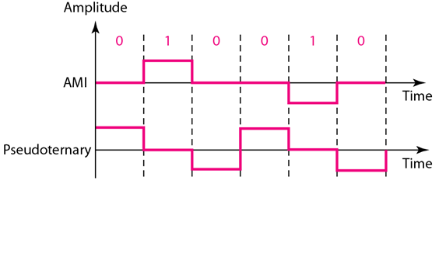
Figure 4.9 Bipolar schemes: AMI and pseudoternary
0- Draw line on the reference line
1- Draw line above/below (alter) of the reference line
Exercise: (i) 10011100
(ii) 00101110
1- Draw line on the reference line
0- Draw line above/below (alter) of the reference line
Exercise: (i) 10011100
(ii) 00101110
4.<number>

Slide 28
Figure 4.9 Bipolar schemes: AMI and pseudoternary
Advantage:
Inbuilt error detection technique.
4.<number>

